Slide 1
SALES PERFORMANCE ANALYSIS OF WALMART STORES USING ADVANCED MYSQL TECHNIQUES
Introduction:
Walmart, a major retail chain, operates across several cities, offering a wide range of products. The dataset
provided contains detailed transaction data, including customer demographics, product lines, sales figures, and
payment methods. This project will use advanced SQL techniques to uncover actionable insights into sales
performance, customer behavior, and operational efficiencies.
Business Problem:
Walmart wants to optimize its sales strategies by analyzing historical transaction data across branches,
customer types, payment methods, and product lines. To achieve this, advanced MySQL queries will be
employed to answer challenging business questions related to sales performance, customer segmentation, and
product trends

Slide 2
Task 1: Identifying the Top Branch by Sales Growth Rate
Walmart wants to identify which branch has exhibited the highest sales growth over time. Analyze the total sales
for each branch and compare the growth rate across months to find the top performer
with monthlysales as(
SELECT branch,
EXTRACT(MONTH FROM sale_date) AS SaleMonth ,
round(sum(total),2)AS total_sales
From walmartsales
GROUP BY branch ,EXTRACT(MONTH FROM sale_date)
ORDER BY SaleMonth),
SalesGrowth AS (
SELECT Branch, SaleMonth, total_sales,
LAG(total_sales, 1, 0) OVER (PARTITION BY Branch ORDER BY SaleMonth) AS PreviousMonthSales,
CASE
WHEN LAG(total_sales, 1, 0) OVER (PARTITION BY Branch ORDER BY SaleMonth) IS NULL OR LAG(total_sales, 1, 0) OVER (PARTITION BY Branch ORDER BY SaleMonth) = 0 THEN 0
ELSE (total_sales - LAG(total_sales, 1, 0) OVER (PARTITION BY Branch ORDER BY SaleMonth)) / LAG(total_sales, 1, 0) OVER (PARTITION BY Branch ORDER BY SaleMonth) * 100
END AS GrowthRate
FROM
MonthlySales),
FinalResult AS (
SELECT Branch,
AVG(GrowthRate) AS AverageGrowthRate
FROM SalesGrowth
GROUP BY Branch)
SELECT
Branch, ROUND(AverageGrowthRate, 2) AS AverageGrowthRate
FROM FinalResult
ORDER BY AverageGrowthRate DESC;

Slide 3
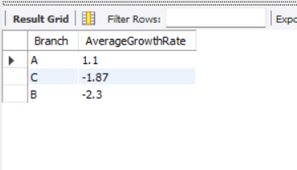
CTE 1: monthlysales
What it does:
Groups sales data by branch and month.
Calculates the monthly total sales per branch.
Extracts the month number (1–12) from the sale date.
Rounds total sales to 2 decimal places.
Why it's done:
To prepare a clean, monthly view of total sales by each branch.This serves as the base for calculating month-over-month growth.
CTE 2: SalesGrowth
What it does:
Retrieves previous month's sales using the LAG() function for each branch.
Computes the growth rate : GrowthRate= Current Sales−Previous SalesPrevious Sales×100GrowthRate= Previous SalesCurrent Sales−Previous Sales​ ×100Sets growth to 0 if no previous month exists or if previous sales = 0.
Why it's done:
To track how sales have grown or declined month-over-month.Helps compare performance within each branch over time.
CTE 3: FinalResult
What it does:
Takes all monthly growth rates per branch.Calculates the average growth rate per branch.
Why it's done:To understand the overall performance trend of each branch.
Useful for identifying consistently growing or underperforming branches.
Final SELECT
What it does:
Selects each branch with its rounded average growth rate.
Sorts the branches in descending order of growth.
Why it's done:
T o present final results clearly.Helps in spotting the top-performing branches.

Slide 4
Task 2: Finding the Most Profitable Product Line for Each Branch
Walmart needs to determine which product line contributes the highest profit to each branch . The profit margin
should be calculated based on the difference between the gross income and cost of goods sold.
With ProfitData AS (
SELECT branch ,
`Product line`,
round(SUM(`gross income`),2) AS total_profit
FROM walmartsales
GROUP BY `Product line`,branch),
RankedProfit AS (
SELECT *,
RANK() OVER (PARTITION BY Branch ORDER BY total_profit DESC) AS ranks
FROM ProfitData)
SELECT branch , `Product line`, total_profit,
CASE
WHEN total_profit >= 1000 THEN 'High'
WHEN total_profit >= 500 THEN 'Medium'
ELSE 'Low'
END AS profit_margin_group
FROM RankedProfit
WHERE rank = 1;

Slide 5
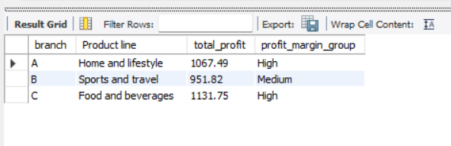
CTE 1: ProfitData
What it does:
Groups data by branch and product line.
Calculates total profit (gross income) for each product line within each branch.Rounds the profit to 2 decimal places.
Why it's done:
To understand how much profit each product line contributes in every branch.
Prepares data for ranking and profit categorization.
2. CTE 2: RankedProfit
What it does:
Assigns a rank to each product line within a branch based on total profit, in descending order.
Uses RANK() function to find the most profitable product line per branch.
Why it's done:
to identify the top-earning product line in each branch.Enables filtering later to focus only on highest contributors.
3. Final SELECT
What it does:
Filters to only show product lines that are ranked 1 (most profitable) in each branch.
Adds a profit margin group:High if profit ≥ 1000Medium if profit ≥ 500Low if profit < 500
Why it's done:
To highlight the most profitable product line in each branch.
Categorizes them for easier comparison and business decision-making.

Slide 6
Task 3: Analyzing Customer Segmentation Based on Spending
Walmart wants to segment customers based on their average spending behavior. Classify customers into three
tiers: High, Medium, and Low spenders based on their total purchase amounts
WITH CustomerSpending AS (
SELECT
`Customer ID`,
round(sum(Total)) AS TotalSpending
FROM
walmartsales
GROUP BY
`Customer ID`
),
SpendingPercentiles AS (
SELECT
TotalSpending,
PERCENT_RANK() OVER (ORDER BY TotalSpending) AS SpendingRank
FROM CustomerSpending )
SELECT
cs.`Customer ID`,
cs.TotalSpending,
CASE
WHEN sp.SpendingRank >= 0.75 THEN 'High Spender'
WHEN sp.SpendingRank >= 0.25 AND sp.SpendingRank < 0.75 THEN 'Medium Spender'
ELSE 'Low Spender'
END AS SpendingSegment
FROM CustomerSpending cs
JOIN
SpendingPercentiles sp ON cs.TotalSpending = sp.TotalSpending
ORDER BY
cs.TotalSpending DESC;

Slide 7
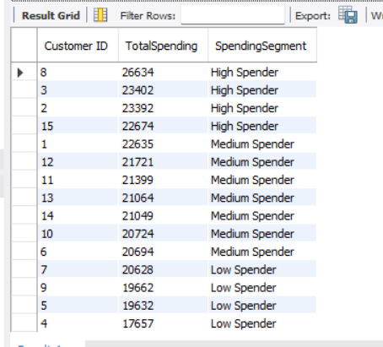
CTE 1: Customer Spending
What it does:
Groups data by Customer ID . Calculates and rounds the total amount spent by each customer
. Why it's done:
To get a summary of how much each customer has spent overall.
This becomes the basis for customer segmentation
.2. CTE 2: Spending Percentiles
What it does:
Uses PERCENT_RANK() to assign a percentile rank based on total spending.
Ranks customers from lowest to highest spender.
Why it's done:
To evaluate each customer’s spending in relation to others.
Prepares for assigning them into different spending tiers.
3. Final SELECT
What it does:
Joins total spending with percentile ranks.
Segments customers as:High Spender: top 25%Medium Spender: middle 50%Low Spender: bottom 25%Sorts customers from highest to lowest spending.
Why it's done:
To classify customers into value segments for marketing, loyalty programs, or targeted offers.

Slide 8
Task 4: Detecting Anomalies in Sales Transactions
Walmart suspects that some transactions have unusually high or low sales compared to the average for the
product line. Identify these anomalies.
WITH ProductLineStats AS (
SELECT `Product line`,AVG(Total) AS AvgSales, STDDEV_SAMP(Total) AS StdDevSales
FROM walmartsales
GROUP BY`Product line),
AnomalyTransactions AS (
SELECT ws.`Invoice ID`, ws.`Product line`,ws.Total,pls.AvgSales,pls.StdDevSales,
CASE
WHEN ws.Total > (pls.AvgSales + 3 * pls.StdDevSales) THEN 'High Anomaly'
anomalies
WHEN ws.Total < (pls.AvgSales - 3 * pls.StdDevSales) THEN 'Low Anomaly'
ELSE 'Normal'
END AS AnomalyStatus
FROM walmartsales ws
JOIN ProductLineStats pls ON ws.`Product line` = pls.`Product line`)
SELECT `Invoice ID`, `Product line, Total,AvgSales, StdDevSales, AnomalyStatus
FROM AnomalyTransactions
WHERE AnomalyStatus <> 'Normal';

Slide 9
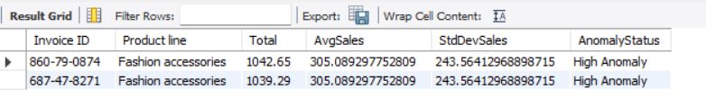
1CTE 1: Product Line Stats
What it does:
Calculates the average sale amount (AvgSales) for each product line.
Calculates the standard deviation (StdDevSales) of total sales within each product line.
Why it's done:
To establish a statistical baseline for detecting unusually high or low sales.
Provides metrics needed to define outliers (anomalies).
2. CTE 2: Anomaly Transactions
What it does:
Joins individual transactions with their product line stats.Flags each transaction as:High Anomaly:
if it exceeds Avg + 3×StdDevLow Anomaly: if it falls below Avg − 3×StdDevNormal: if within the expected range
Why it's done:
To detect outlier transactions that significantly deviate from typical behavior.
Helps identify potential data issues, fraud, or rare events.
3. Final SELECT
Retrieves only the anomalous transactions.
Displays relevant details: invoice ID, product line, actual total, average, standard deviation, and status.
Why it's done:
To focus analysis on unusual sales activity.
Supports investigation or corrective action where needed.

Slide 10
Task 5: Most Popular Payment Method by City
Walmart needs to determine the most popular payment method in each city to tailor marketing strategies
WITH PaymentCounts AS (
SELECT
City,
Payment,
COUNT(*) AS PaymentCount,
ROW_NUMBER() OVER (PARTITION BY City ORDER BY COUNT(*) DESC) AS rn
FROM
walmartsales
GROUP BY
City,
Payment
)
SELECT
City,
Payment AS MostPopularPaymentMethod
FROM
PaymentCounts
WHERE
rn = 1;

Slide 11
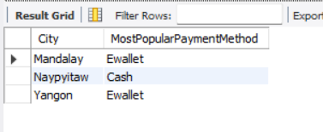
CTE: PaymentCounts
What it does:
Groups data by City and Payment method.
Counts how many times each payment method was used in each city.
Uses ROW_NUMBER() to rank payment methods by frequency within each city.
Why it's done:
To determine the most commonly used payment method per city.
Prepares data for filtering only the top-ranked method in each city.
2. Final SELECT
What it does:
Filters the ranked data to get only row number = 1, i.e., the most used payment method per city.
Why it's done:
To present the most popular payment method in each city in a clean and focused way.

Slide 12
Task 6: Monthly Sales Distribution by Gender
Walmart wants to understand the sales distribution between male and female customers on a monthly basis.
select
extract(month from sale_date) as salemonthly ,
gender,
ROUND(SUM(Total), 2) AS totalSales
from walmartsales
group by extract(month from sale_date) ,gender
ORDER BY
SaleMonthly,
Gender;

Slide 13
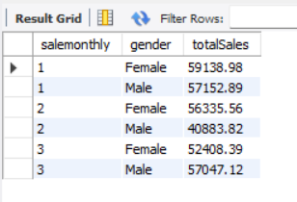
.1 SELECT Clause
What it does:
Extracts the month from the sale_date column and names it SaleMonthly
Groups the data by gender.
Calculates and rounds the total sales for each gender per month.
Why it's done:
To analyze monthly sales trends broken down by gender.
Helps compare how male vs. female customers contributed to sales over time
.2. GROUP BY Clause
What it does:
Groups the data by month and gender to aggregate totals correctly.
Why it's done:
Enables separate sales totals for each gender in each month.
3. ORDER BY Clause
What it does:
Sorts the result first by month, then by gender.
Why it's done:
Ensures the output is organized chronologically and cleanly grouped by gender.

Slide 14
Task 7: Best Product Line by Customer Type
Walmart wants to know which product lines are preferred by different customer types
WITH ProductLineFrequencyByType AS (
SELECT
`Customer type`,
`Product line`,
COUNT(*) AS PurchaseFrequency,
ROW_NUMBER() OVER (PARTITION BY `Customer type` ORDER BY COUNT(*) DESC) AS rn
FROM
walmartsales
GROUP BY
`Customer type`,
`Product line`
)
SELECT
`Customer type`,
`Product line` AS MostFrequentProductLine,
PurchaseFrequency
FROM
ProductLineFrequencyByType
WHERE
rn = 1;

Slide 15
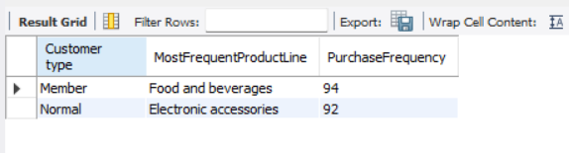
CTE: Product Line Frequency By Type
What it does:
Groups data by Customer type (e.g., Member or Normal) and Product line.
Counts how many times each product line was purchased per customer type.
Ranks product lines within each customer type using ROW_NUMBER() based on purchase frequency (most to least).
Why it's done:
To find out which product line is most frequently purchased by each type of customer.
Prepares for filtering just the top product line per customer category.
2. Final SELECT
What it does:
Filters to include only rank 1 entries (most purchased product line per customer type).
Displays customer type, the most frequent product line, and its purchase count.
Why it's done:
To highlight the top product preference of each customer type for targeted marketing or stocking strategies.

Slide 16
Task 8: Identifying Repeat Customers
Walmart needs to identify customers who made repeat purchases within a specific time frame (e.g., within 30
days).
WITH CustomerPurchases AS (
SELECT `Customer ID, sale_date,
ROW_NUMBER() OVER (PARTITION BY `Customer ID` ORDER BY sale_date) as PurchaseNumber,
LAG(sale_date, 1, NULL) OVER (PARTITION BY `Customer ID` ORDER BY sale_date) as PreviousPurchaseDate
FROM walmartsales),
RepeatPurchaseDates AS (
SELECT `Customer ID`, sale_date,
DATEDIFF(sale_date, PreviousPurchaseDate) AS DaysSinceLastPurchase
FROM CustomerPurchases
WHERE PurchaseNumber > 1)
SELECT DISTINT `Customer ID`
FROM RepeatPurchaseDates
WHERE DaysSinceLastPurchase <= 30;

Slide 17
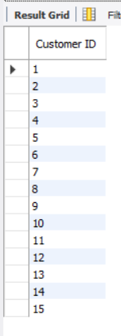
CTE 1: CustomerPurchases
What it does:
For each Customer ID, assigns a purchase number using ROW_NUMBER() (ordered by sale_date).Uses LAG() to get the date of the previous purchase for each customer.
Why it's done:
To track the sequence of purchases and calculate the time between repeat purchases.
2. CTE 2: RepeatPurchaseDates
What it does:
Calculates the number of days between current and previous purchase using DATEDIFF().
Why it's done:
To identify how soon a customer returns after a purchase — useful for tracking loyalty or buying habits.
3. Final SELECT
What it does:
Filters and returns distinct customers who made repeat purchases within 30 days.
Why it's done:
To identify engaged or loyal customers based on repeat buying within a short period.

Slide 18
Task 9: Finding Top 5 Customers by Sales Volume (
Walmart wants to reward its top 5 customers who have generated the most sales Revenue
SELECT
`Customer ID`,
round(SUM(Total),2)AS TotalRevenue
FROM
walmartsales
GROUP BY
`Customer ID`
ORDER BY
TotalRevenue DESC
LIMIT 5;

Slide 19
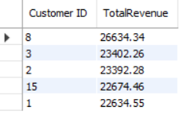
SELECT Clause
What it does:
Retrieves each Customer ID.
Calculates and rounds the total revenue they generated using SUM(Total).
Why it's done:
To find out how much each customer has contributed to overall sales.
2. GROUP BY Clause
What it does:
Groups data by Customer ID to aggregate revenue per customer.
Why it's done:
Ensures accurate total revenue per individual customer.
3. ORDER BY & LIMIT
What it does:
Sorts customers by highest revenue first.
Limits the result to top 5 highest-spending customers.
Why it's done:
To highlight the most valuable customers based on revenue contribution.

Slide 20
Task 10: Analyzing Sales Trends by Day of the Week
Walmart wants to analyze the sales patterns to determine which day of the week brings the highest sales.
SELECT
WEEKDAY(sale_Date) AS DayIndex,
round(SUM(Total),2) AS TotalSales
FROM
walmartsales
GROUP BY
DayIndex
ORDER BY
TotalSales DESC
LIMIT 1;

Slide 21
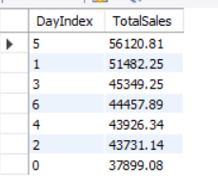

SELECT Clause
What it does:
Uses WEEKDAY(sale_date) to get the day index (0 = Monday, 6 = Sunday).
Calculates total sales for each day index and rounds it.
Why it's done:
To analyze sales volume by day of the week using numerical day values.
2. GROUP BY Clause
What it does:
Groups transactions by day index to sum up sales per weekday.
Why it's done:
To compare sales performance for each day.
3. ORDER BY & LIMIT
What it does:
Sorts days based on highest total sales.
Returns only the top-performing day (highest sales).
Why it's done:
To quickly identify which day has the highest revenue, aiding in scheduling and planning.

